Slide 1
Capstone Proposal:
An Efficient and Cost-Friendly
Affective Judgment Prompting Method for
Multimodal LLMs
Tingfu Zhou

Slide 2
Outline
Introduction
Problem Definition
Preliminary Knowledge
Related Works
Innovation
Specific Methods
Experiments and Analysis
Progress Estimate

Slide 3
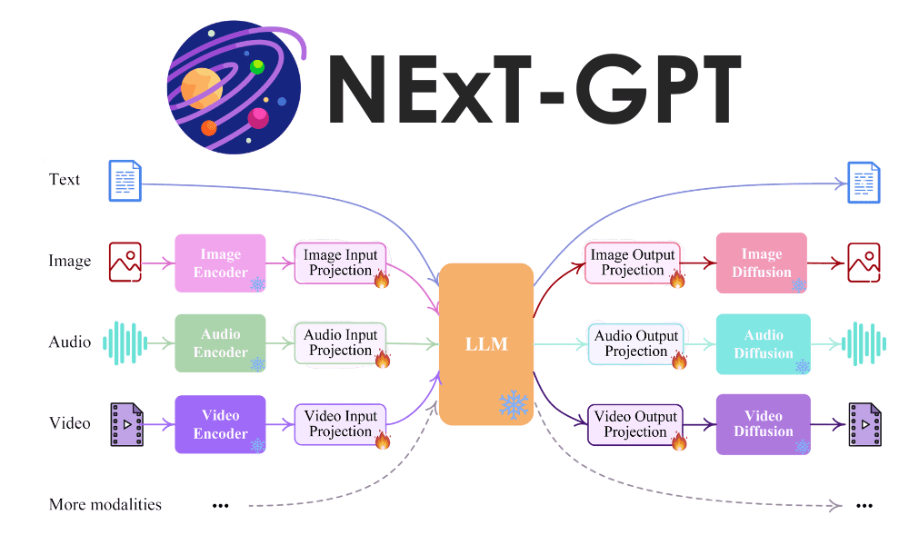

Introduction
With the development of deep learning, multimodal LLMs began to show its powerful understanding and reasoning capabilities.
This provide an new option for sentiment analysis

Slide 4


Introduction
In the real life, sentiment analysis can be applied to many products:
existing AI chat companion， AI assistant
Combining it with existing products or even with humanoid robots is a very potential market direction.

Slide 5
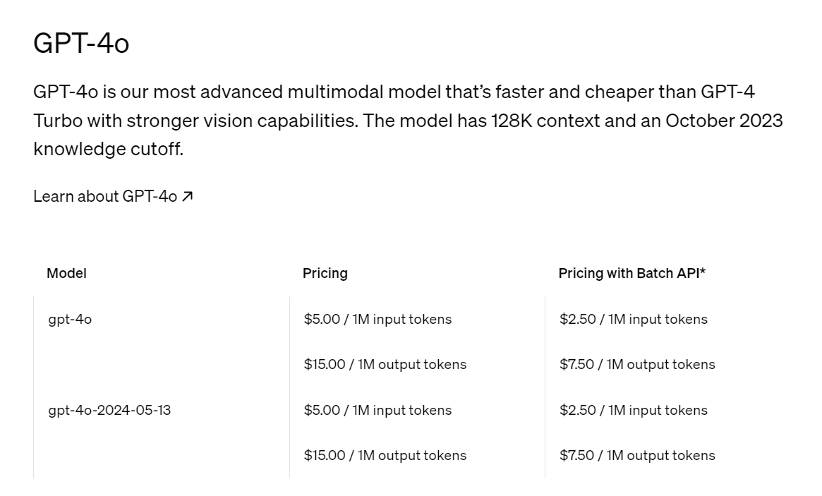
Introduction
However, due to the scale law, an efficient LLM has a large model size and training data volume. This makes training or fine-tuning an efficient LLM very expensive.
In this case, using API is a efficient and cost-friendly option.

Slide 6
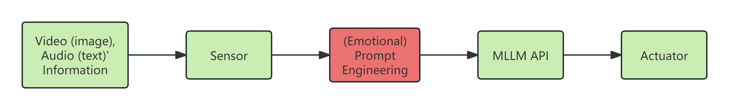
Problem Definition
Given multimodal inputs, comprising both images and text, the task is to utilize the API of Multimodal Large Language Models (MLLMs) to analyze and interpret the emotional information contained within these inputs.

Slide 7
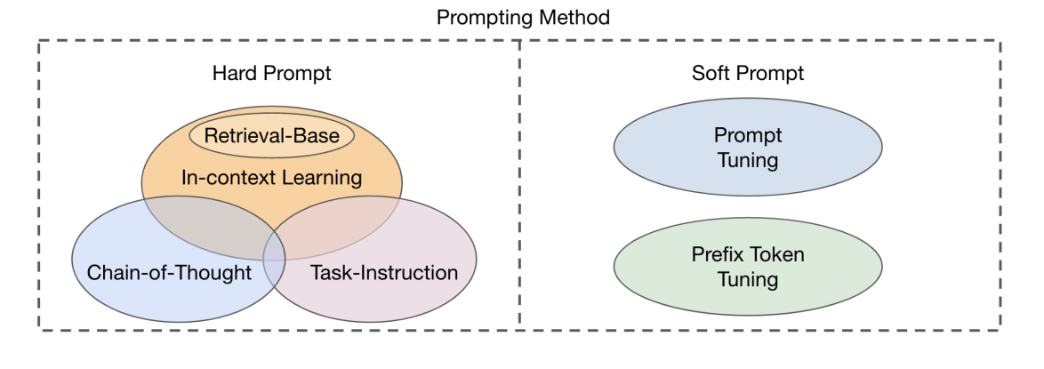
Preliminary Knowledge
Hard prompt: it refers to text input provided directly to the model.
Soft prompt: it involve adjusting or optimizing the model's input vectors (i.e., the model's internal representation).
In short, hard prompt does not need to change the model itself.

Slide 8
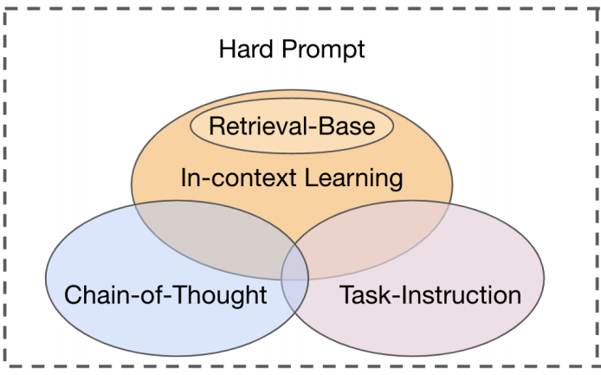
Preliminary Knowledge
Task Instruction Prompting: A technique that motivates a model to perform a specific task by providing it with explicit task instructions.
In-context Learning: The model generates corresponding output by analyzing and imitating examples in the input without explicit transfer learning or fine-tuning.
Retrieval-based Prompting: Retrieve relevant information before generating a response to enhance the model's output quality and relevance.
Chain-of-Thought Prompting: Improve the accuracy and transparency of complex problem solving by guiding the model to demonstrate its step-by-step reasoning process for solving problems.

Slide 9
Related Works
Existing sentiment analysis prompt method for MLLMs:
[9]. A prompt-based approach to visual perceptual language modeling that leverages small amount of supervised data.
[10]. Introduced Memo BERT, a pre-trained model designed for multimodal transformation.
[11]. Using trainable templates rather than manual ones and applied an adversarial training method.
[12]. Introduced an image classification algorithm called PMHANet, it designed specific strategies for fine-tuning, feature selection, and semantic guidance during the transfer process of pre-trained models.
[13]. Employ parameter-efficient fine-tuning to efficiently fine-tune LLMs. Also, they use emotion cause-aware prompt-based learning and instruction-tuning to improve model performance
They focus on video (image) information, or model-level methodologies, or need training/fine-tuning (it need to change the model itself, it is expensive)

Slide 10
Innovation
The innovations of this paper are outlined as follows: (Delivery target upon completion)
1) I propose an efficient and cost-effective affective judgment prompting method for multimodal LLMs. (Delivery target upon completion)
2) Several experiments demonstrate that, while maintaining cost control, my algorithm can judge emotions in multimodal situations more accurately than existing prompting methods.
3) Several experiments show that my prompting method effectively enhances the sentiment analysis capabilities of current market MLLMs.

Slide 11
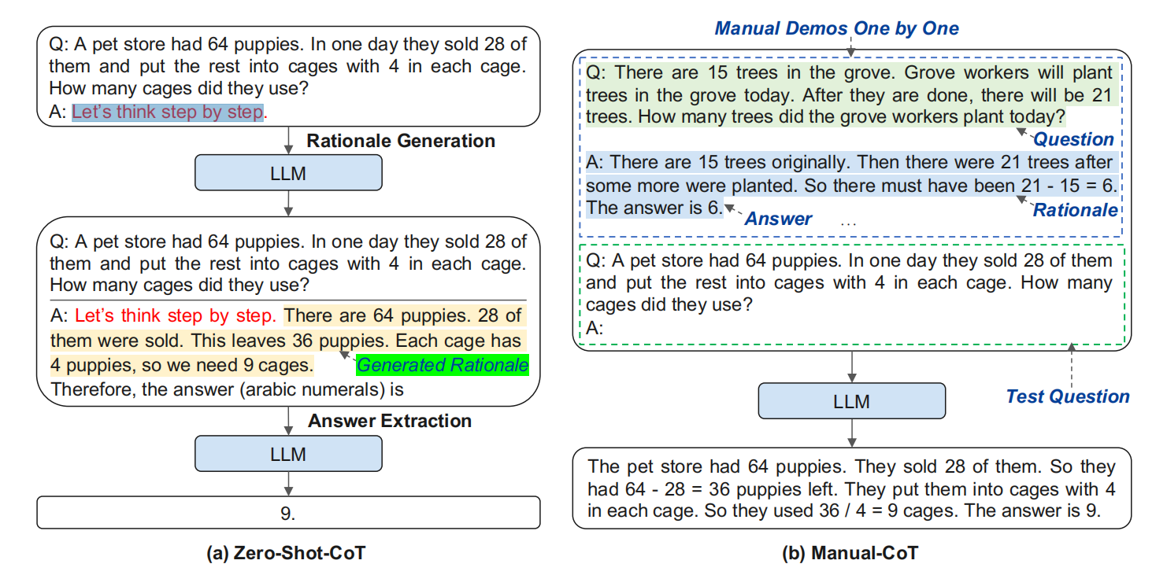
Specific Methods
I plan to initially utilize task instruction and chain-of-thought (CoT).

Slide 12
Specific Methods
Apply some of the skills in multimodal sentiment analysis when designing prompt words/outline.
The skill of multimodal can be polar words (terms with positive or negative connotations), pauses feature, combining visual sentiments with text data...
If the experiment shows the performence is good, that will be fine, if not, I will use more complex method like retrieval-based prompting.

Slide 13
Experiments and Analysis
Since manual assessment is labor-intensive, I will employ GPT scoring for rating, using GPT-4o to valuate responses.
API expected to be used: GPT-4o, ERNIE, HUNYUAN, DashScope.
Dataset expected to be used: MOSI dataset, CMU-MOSEI dataset, MELD dataset

Slide 14
Progress Estimate
Week 1 & 2: Engage in a thorough literature review and initially determine the model framework.
Week 3 to 5: Conduct experiments and refine the model based on the experimental results.
Week 6: Focus on drafting and revising the academic paper.

